Slide 1
Enterprise eSignature Capability PoV
Lala Liu, Michael Gitberg, John Falkl
September 2020

Slide 2


Executive Summary
Adobe Sign is broadly used in CVS enterprise, while DocuSign is the most used market contender in the space. How to position their capabilities in order to best benefit CVS?
Opportunity
Observation
TAI Perspective
Multiple lines of business in CVS require eSignature capability
Adobe Sign and DocuSign are the top solutions and contenders in the market
Can a single eSignature solution satisfy the cross-CVS need?
What would CVS benefit by having an alternative solution?
Adobe Sign is used across CVS LOBs (HCB, Retail/Shared services, PBM)
The Enterprise License Agreement (ELA) with Adobe Sign covers 1 million transaction per year, currently have 3K+ active users
DocuSign was adopted by Meritain through an integrated contract management (CM) ability with Saleforce
Both Adobe and DocuSign are long term Aetna customers
Adobe Sign has become the de-facto enterprise standard for electronical signature in most cases
DocuSign is an integral part of some contract management solutions
This is an appropriate technology usage, and recommend continuing to use both products, Adobe Sign for general eSignature use, and DocuSign where it is embedded in contract management solutions

Slide 3


eSignature Product Deployed within CVS vs.
Sales & Service
Contract forms
Broker Agreement
Plan Sponsors
Banking
Legal
Agreements
Consents
State forms
Legal Holds
Affidavits
Human Resources
Contracts
Change Requests
Engagement letters
Memorandum
Finance
Invoicing
Expense
Auditing
Policy
Specialty
Health Fund (PayFlex)
Pharmacy
Coram
Caremark
Retail
Inventory
Supply
HCB
Commercial
Government (Medicare)
Specialties
Procurement
Purchasing
Statement of Work
Agreements
Contracts
RFP
Affiliate
TPA (Meritain) Sales operations

Slide 4
Professional Opinions on eSignature Products
Key considerations per IDC and Gartner analysts in respect to both products
for Enterprise
Business Pro
Comparable eSignature capability, can accommodate contract lifecycle mgmt (CLM)
IDC seen clients move from DocuSign to Adobe Sign due to cost.
No extra costs and include professional services
Maintained 35% year-to-year growth rate
Strong integration with Microsoft* (365, SharePoint, Dynamics), many other integrations including Salesforce, SAP, ServiceNow...
Offer incentives to move from DocuSign
Comparable eSignature capability, excel in CLM. A strong customer facing brand
Generally cost 30-50% more than Adobe Sign*
Be careful because of many additional costs
More 3rd party connectors (typically built by the 3rd parties). Strong relationship with SAP
Has a better roadmap on Contract Management, planning AI capabilities (acquired Seal Software)
APIs are more difficult to work with
Strong notary capably
Actively reach out to business leaders for sales
* Adobe Sign is Microsoft’s preferred e-signature solution
*Cost perspective is based on 200+ customer contract reviews conducted by Gartner analyst in the last six months
Notes:
Spring CM and Seal both acquired by DocuSign, all has ELA with CVS

Slide 5

Market Opinions on eSignature Products
Category | Adobe Sign | DocuSign
Cost | Include service, training, etc. No extra charge | ‘piece meal’ charges, limit user# by plan
SaaS cloud architecture
API |  | Report difficulty to work with
Mobile | Use Android mobile
Security strong focus | Enterprise | SMB
Popularity | Enterprise & companies w/ Adobe product | Smaller companies
Easy UI to non-expert |  | Strong customer facing
Legal & Compliance
Customer support experience |  | Report insufficient or slowness
Contract Lifecycle Mgmt (CLM) |  | Can buddle with Spring CM tool
End-to-end workflow | Lead workflow design/signing for web/mobile | Difficult to alter document after creation
Market share trend | 5% (15% in 2016) | 69% (40% in 2016)
Integrations | Vertical integration with Adobe Suite, horizontal integration with Microsoft, SalesForce, Google, Box, SAP, Apttus, Oracle, ServiceNow, SABA, Workday… | 350 third party connectors
Language support Sign/sending | 34 / 34 | 44 / 14
Data sources: G2.com, TrustRadius.com, SoftwareAdvice.com, Linksquares.com, IDC, Gartner
Notes:
Data source listing

Slide 6
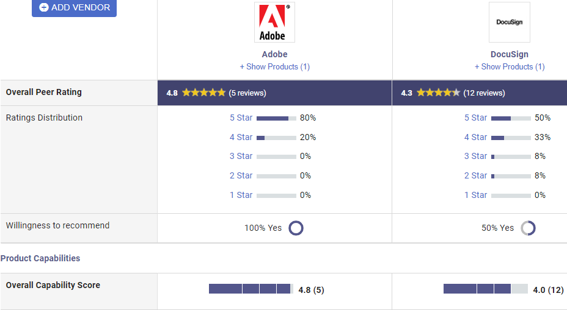
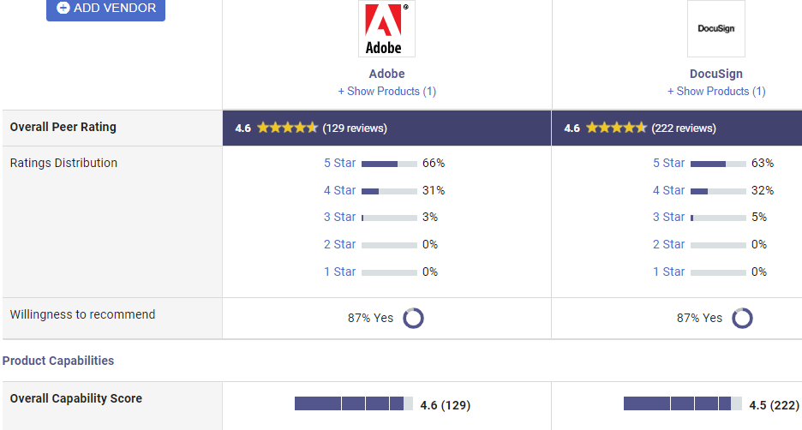
External Customer Peer Reviews
Recent 12 months
Overall Rating
Data sources: Gartner

Slide 7
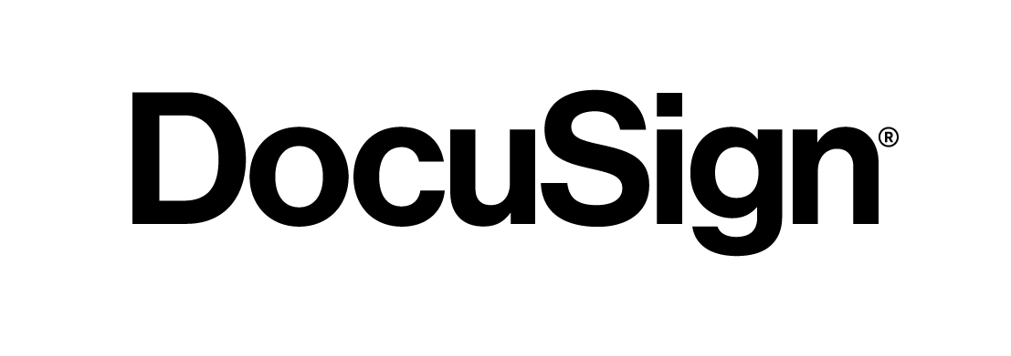
Internal Customer Experience and Feedbacks
Who: Aetna Small Group Sales, 600+ users
When: Start 2015 (ramp up in 9 – 12 months)
Where: Enterprise Saleforce Marketing Cloud
What: Embed in Sales operations, also adopted externally by 10K+ brokers and plan sponsors
How: Maintain 4K forms, ~20K transactions/year
Feedback: Adobe Sign works well for our purpose, no interest to change
We don’t need CM functions
The mobile capability already meet the need
We are increasing usage, can’t afford destruction
Any change must be seamless to clients
Change means to fix something that’s not broken
Change will create tremendous amount of rework
Cannot change during Aug-March each year
Who: Meritain, ~170 users
When: Start 2018 (w/ Spring CM, still ramp up)
Where: Saleforce Marketing Cloud Meritain instance
What: Integrate Spring CM (DocuSign acquisition) w/ SaleForce to perform Sales contract operations
How: Utilize CM tool, up to ~8K transactions 1st year
Feedback: DocuSign is the perfect tool to meet our need, other products are not
We need to use the CM functions (like redlining)
DocuSign was brought in at the right time when we start CM, seamlessly added signing capability
We are ramping up the utilization, may double the transactions next year
It would be good to have an ELA so that to combine with enterprise users for better pricing

Slide 8
Leveraging eSignature Capability in CVS Fact based analysis on Adobe Sign and DocuSign
Capabilities
COST
Time, Labor & Experience
eSignature Capability of both products are comparable, and satisfy the business requirement as they currently deployed
CM Capability is an optional integration of DocuSign, it will only benefit to the business that require embedded CM function
Architecture of both products aligned well with CVS, there is no technology gain to switch from one product to another
License covered in Adobe Sign ELA can be shared across LOBs. Adding or switching to DocuSign license will most definitely cost more to CVS
Value of ELA is packaged with service and training. Adding or switching to DocuSign would incur itemized cost, and reduce value to price
Volume in ELA should be leveraged to its maximum, adding vendor will not only cost extra but also under-utilize the already paid services
Deployment of Adobe Sign took time to become operationalized in multiple LOBs, and to adopt for external customers
Rework is unavoidable if switch product
Customer experience will be impacted without producing any tangible benefit
TAI Perspective
eSignature adoption is decided by individual business unit
Adobe Sign and DocuSign are both appropriate products in delivering eSignature capability into CVS
Adobe Sign has broad adoption in CVS, because of the ELA it is beneficial to continue as de-facto eSignature solution
DocuSign is the product of choice when requires eSignature to be embedded in contract management solutions

Slide 9
Into Action.
Turning Vision…

Slide 10
Business Clients Relationships
Adobe Inc. and DocuSign are both long term Aetna clients
Adobe: since 1995, has 22,600 employees worldwide. One of the premier accounts, always a willing reference for Aetna business
Sold Aetna products: Medical, Rx, EAP, Intl World Traveler, bSwift, Return Ready Service (new 2020)
2020 subscribers ~9,500, Active members ~ 26,000
DocuSign: since 2011, has 3900 employees, Aetna is a primary plan
Sold Aetna products: Medical, Rx, bSwift, PayFlex HSA, Supplemental Voluntary suite (9/1/2020)
2020 subscribers = 2,828, Active members = 5,200
Other Facts of DocuSign
DocuSign purchased Spring CM (2018) and Seal Software (2020)
Spring CM: has active contract with Aetna/CVS, currently used by Meritain as contract management solution
Seal Software: also has contract with Aetna since 3-5 years ago as part of the CLM program that started with Procurement and Legal and expanded to Provider and Plan Sponsor. DocuSign will offer AI capability from Seal product.

